Slide 1
Control Theory(2nd)
By JunAng Wang
2023/11/24

Slide 2
Recap
Mechanics and Dynamics of Uniform Magnetization Rods
Intro of Control Theory
Intro of Control Models
PID controller

Slide 3
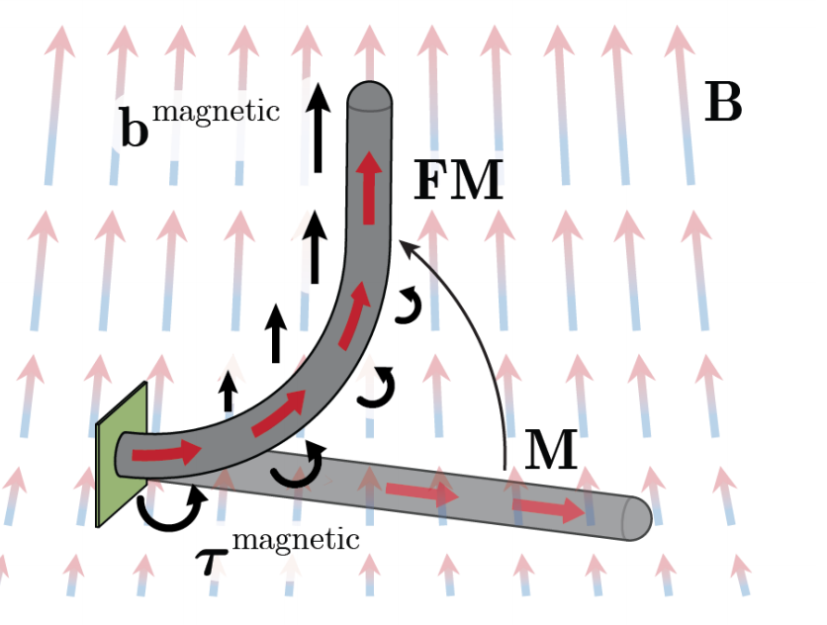
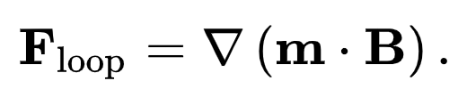
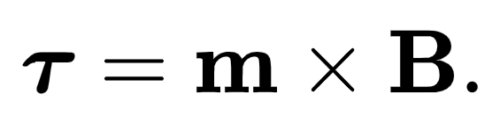
Deflection of Uniform Magnetization Rod
Yoonho Kimet al. 2019

Slide 4
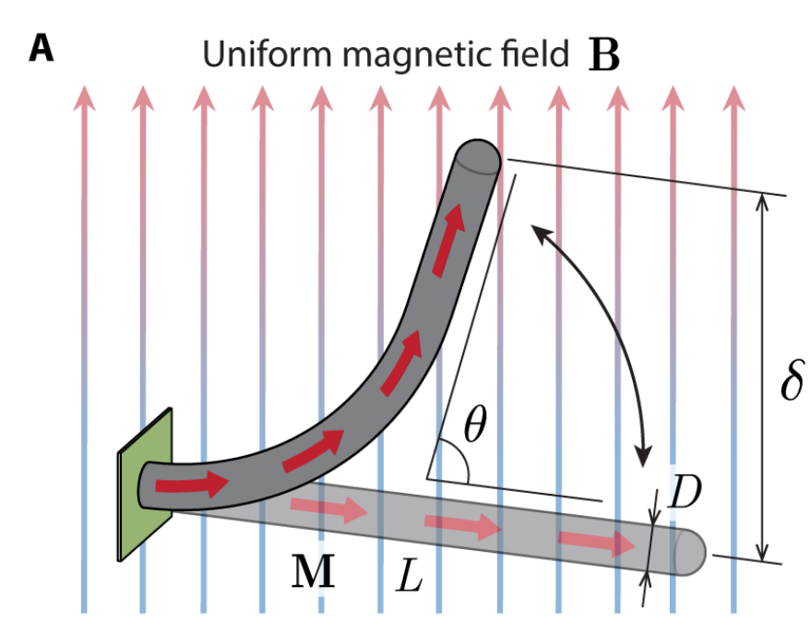
Deflection of Uniform Magnetization Rod
Yoonho Kimet al. 2019

Slide 5
Deflection of Uniform Magnetization Rod
Only torque is considered
Yoonho Kimet al. 2019

Slide 6
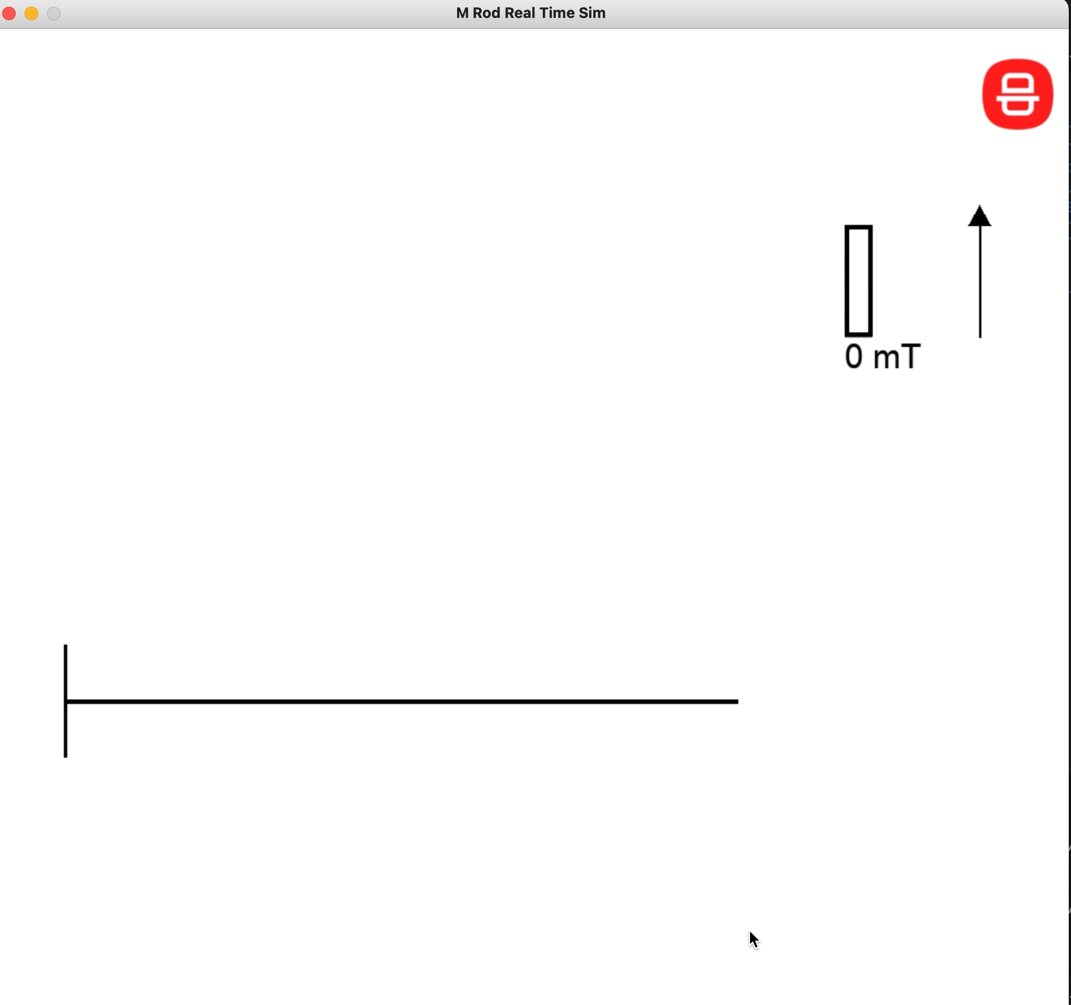
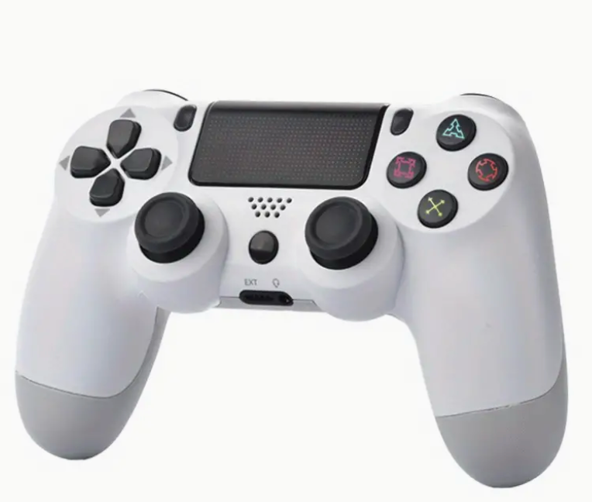
Quasi-Real-Time Simulator

Slide 7
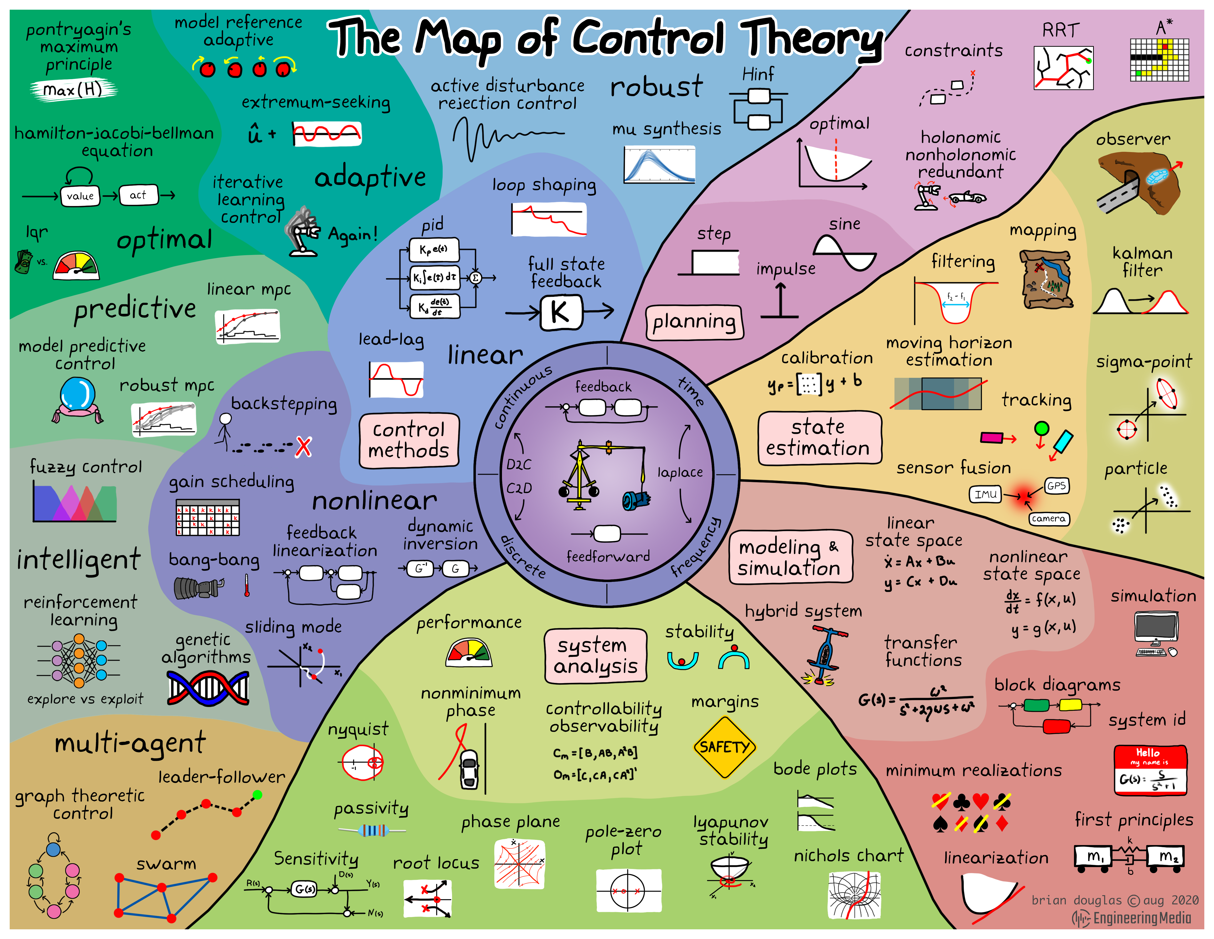
Intro of Control Theory
https://engineeringmedia.com

Slide 8
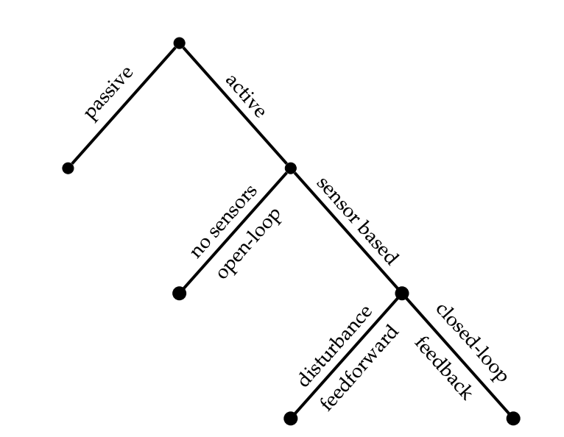
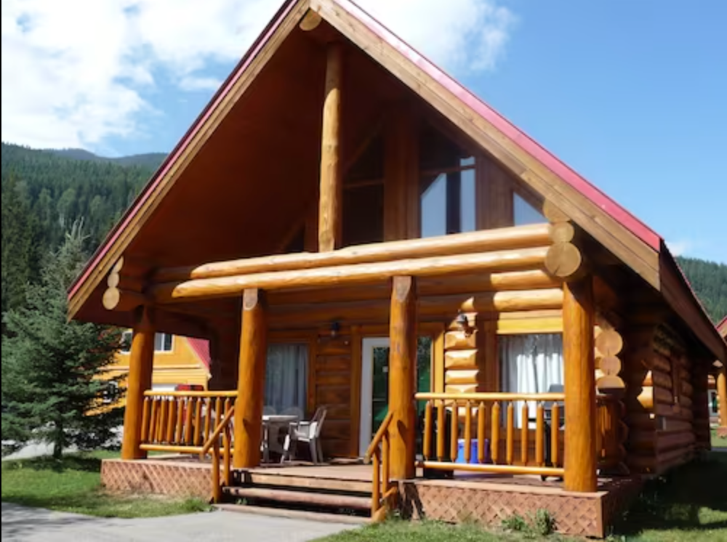
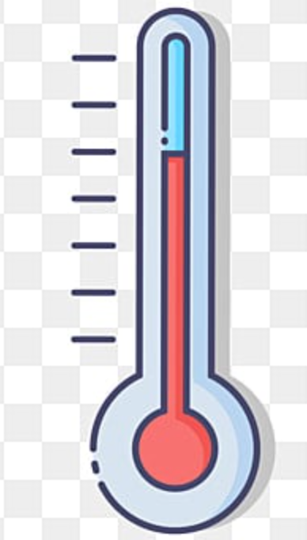
Intro of Control Models
Passive control models
Active control models
Brunton & Kutz 2017

Slide 9
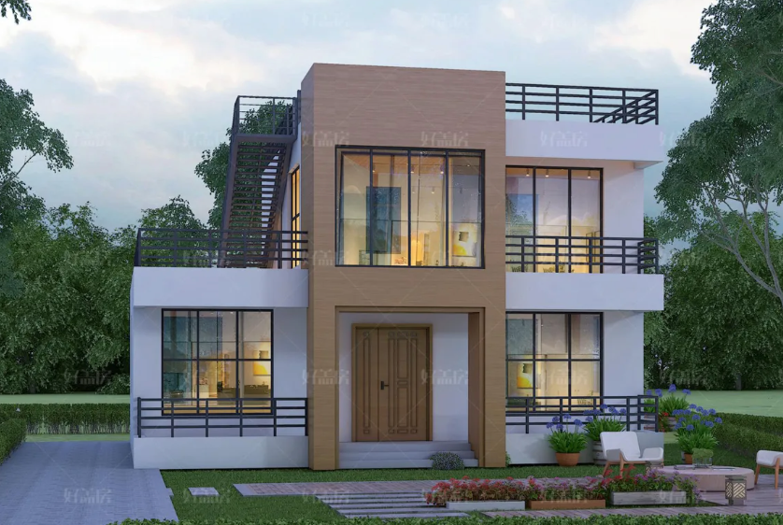
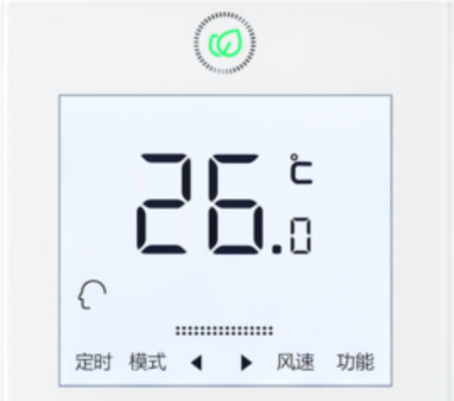
Intro of Control Models
Passive control models
Active control models
Brunton & Kutz 2017

Slide 10

Intro of Control Models
Passive control models
Active control models
Brunton & Kutz 2017

Slide 11

Intro of Control Models
Passive control models
Active control models
Brunton & Kutz 2017

Slide 12
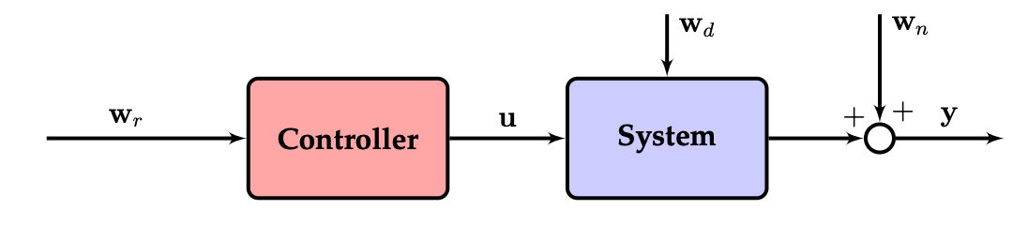
Intro of Control Models
Open Loop control models
Closed Loop control models
Brunton & Kutz 2017

Slide 13
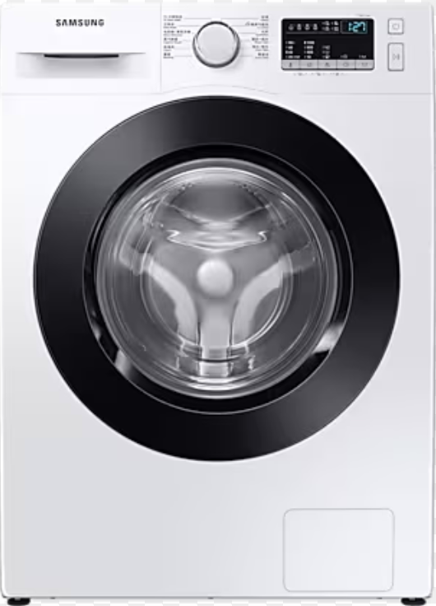
Intro of Control Models
Open Loop control models
Closed Loop control models
Brunton & Kutz 2017

Slide 14
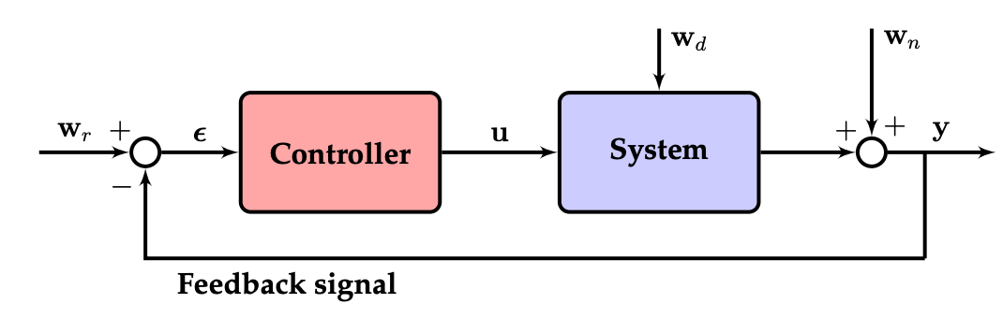
Intro of Control Models
Open Loop control models
Closed Loop control models
Brunton & Kutz 2017

Slide 15
Intro of Control Models
Open Loop control models
Closed Loop control models
Brunton & Kutz 2017

Slide 16
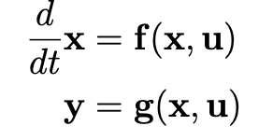
Intro of Control Models
Closed Loop control models
Brunton & Kutz 2017

Slide 17
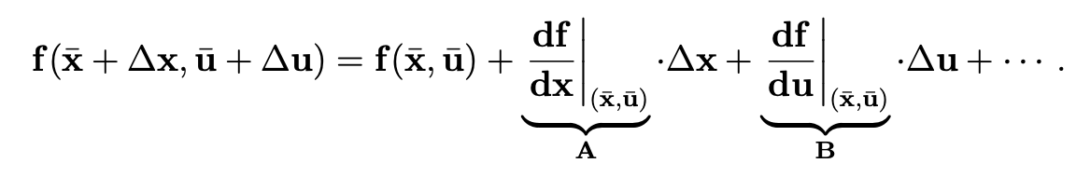
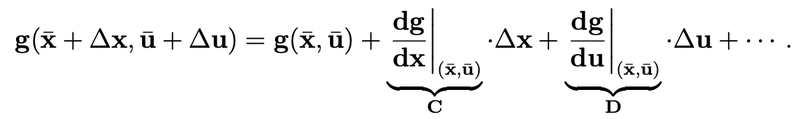
Intro of Control Models
Closed Loop control models
Brunton & Kutz 2017

Slide 18
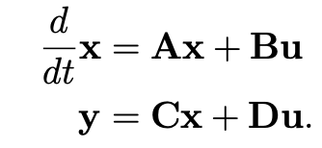
Intro of Control Models
Closed Loop control models
Brunton & Kutz 2017

Slide 19
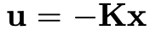
Intro of Control Models
Closed Loop control models
Brunton & Kutz 2017

Slide 20
Intro of Control Models
Closed Loop control models
Linear Controller
Brunton & Kutz 2017

Slide 21
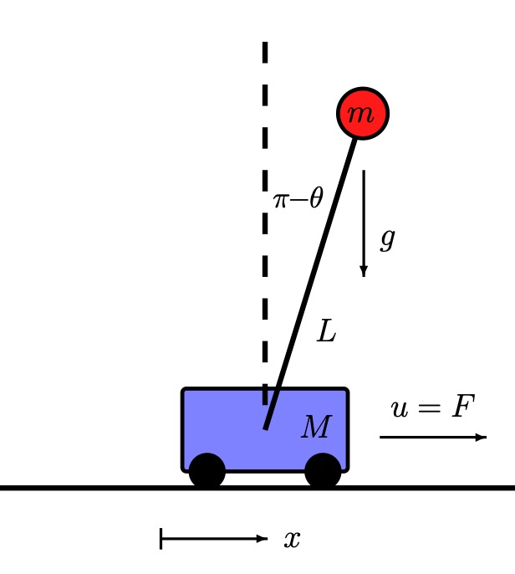
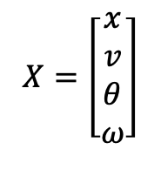
Intro of Control Models
Closed Loop control models
$$X=\left[\begin{matrix}x \\ v \\ θ \\ ω\end{matrix}\right]$$
Linear Controller
Brunton & Kutz 2017

Slide 22
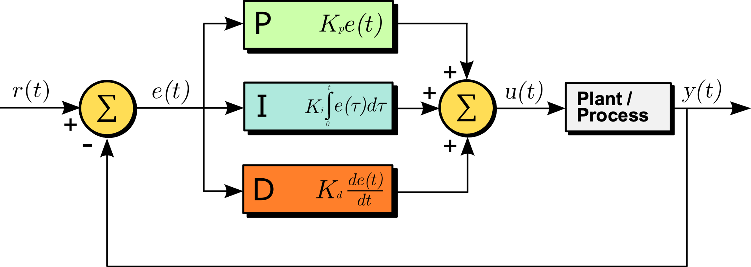
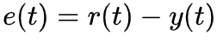
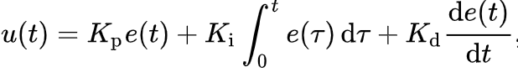
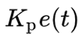
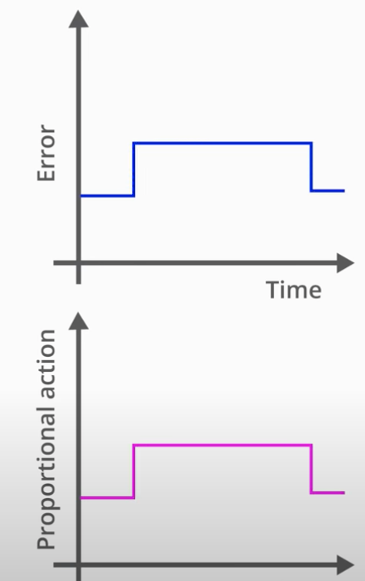
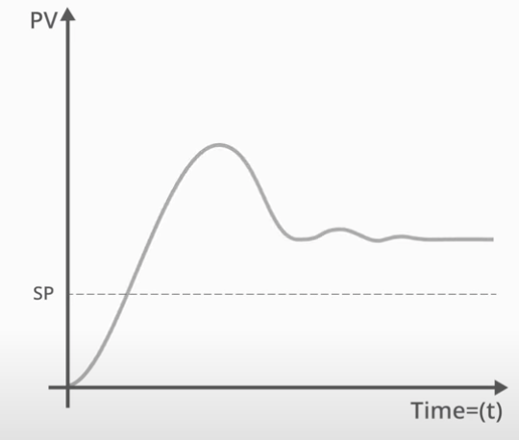
Proportional-integral-derivative (PID)

Slide 23
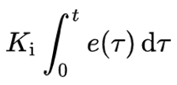
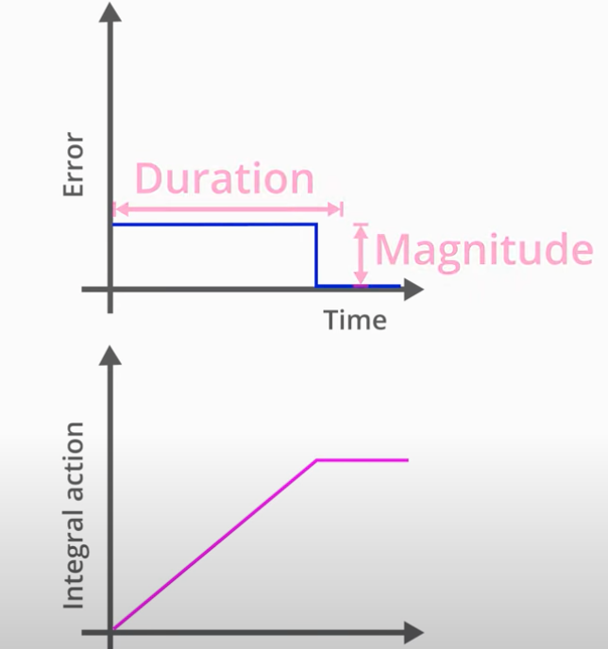
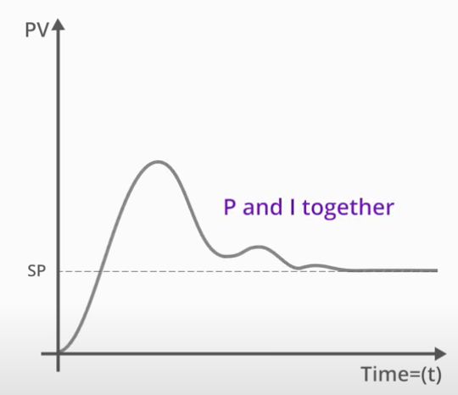
Proportional-integral-derivative (PID)

Slide 24
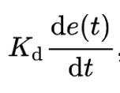
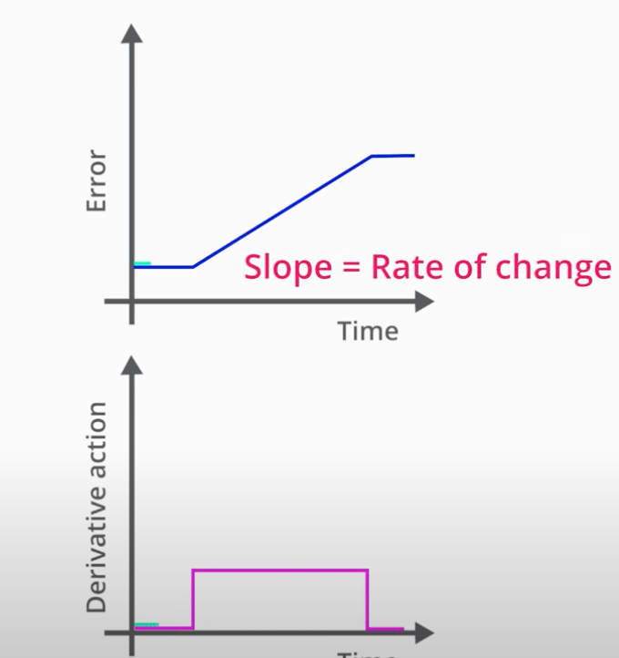
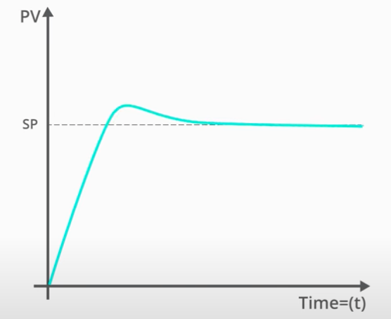
Proportional-integral-derivative (PID)

Slide 25
Proportional-integral-derivative (PID)
Yoonho Kimet al. 2019

Slide 26
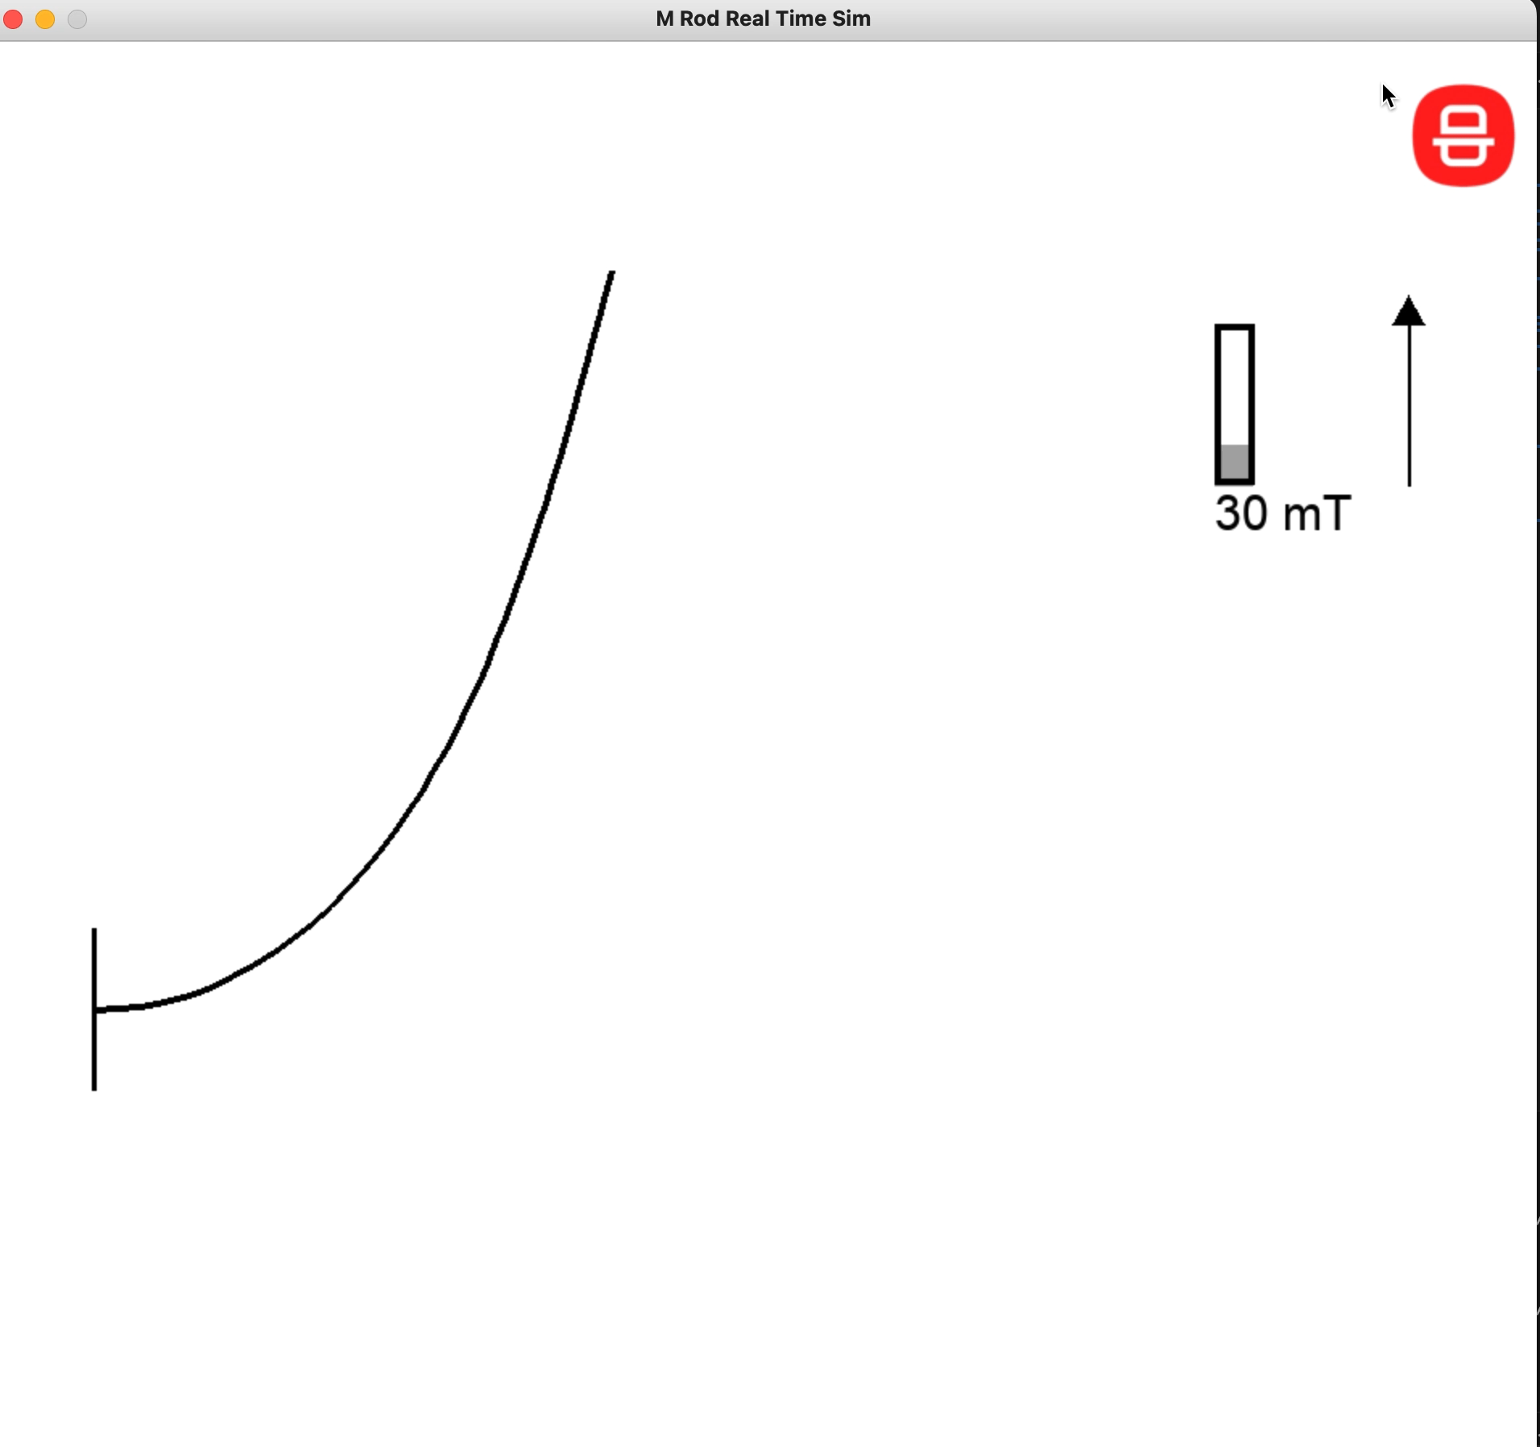

Proportional-integral-derivative (PID)

Slide 27
Overview
Tuning PID Controller
Linear Quadratic Regulator
Data-Driven Control
Model Predictive Controller

Slide 28

Tuning PID Controller

Slide 29
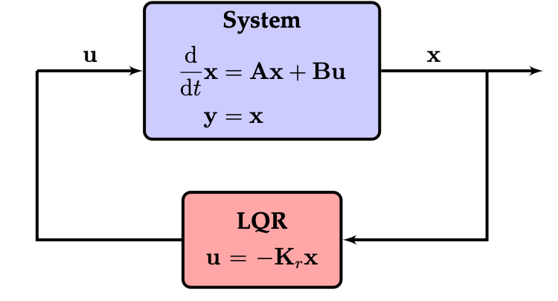
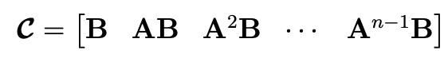
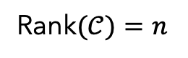
Linear System and Linear Control
Controllability: reach any state I want
Rank$(𝒞)=n$
2021 Brunton & Kutz

Slide 30
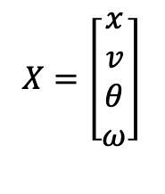
Linear System and Linear Control
Controllability: reach any state I want
Rank$(𝒞)=n$
$$X=\left[\begin{matrix}x \\ v \\ θ \\ ω\end{matrix}\right]$$
2021 Brunton & Kutz

Slide 31
Linear System and Linear Control
Controllability: reach any state I want
Rank$(𝒞)=n$
$$X=\left[\begin{matrix}x \\ v \\ θ \\ ω\end{matrix}\right]$$
2021 Brunton & Kutz

Slide 32
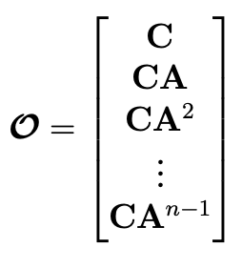
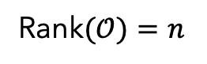
Linear System and Linear Control
Controllability: reach any state I want
Rank$(𝒞)=n$
Observability: estimate any state I want
$$X=\left[\begin{matrix}x \\ v \\ θ \\ ω\end{matrix}\right]$$
Rank$(𝒪)=n$
2021 Brunton & Kutz

Slide 33
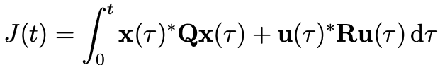
Linear Quadratic Regulator
Cost function
2021 Brunton & Kutz

Slide 34
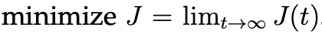

Linear Quadratic Regulator
Cost function
Design $K_{r}$to minimize
2021 Brunton & Kutz

Slide 35
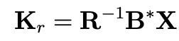
Linear Quadratic Regulator
Cost function
Design $K_{r}$to minimize
2021 Brunton & Kutz

Slide 36
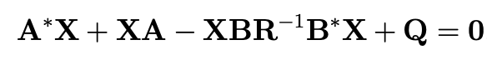
Linear Quadratic Regulator
Cost function
Design $K_{r}$to minimize
2021 Brunton & Kutz

Slide 37
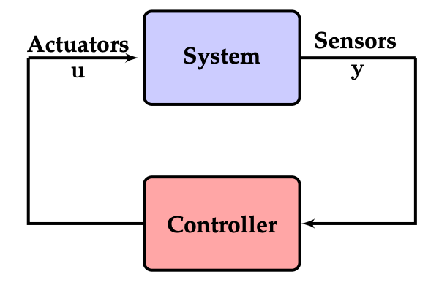
Data-Driven Control
2021 Brunton & Kutz

Slide 38
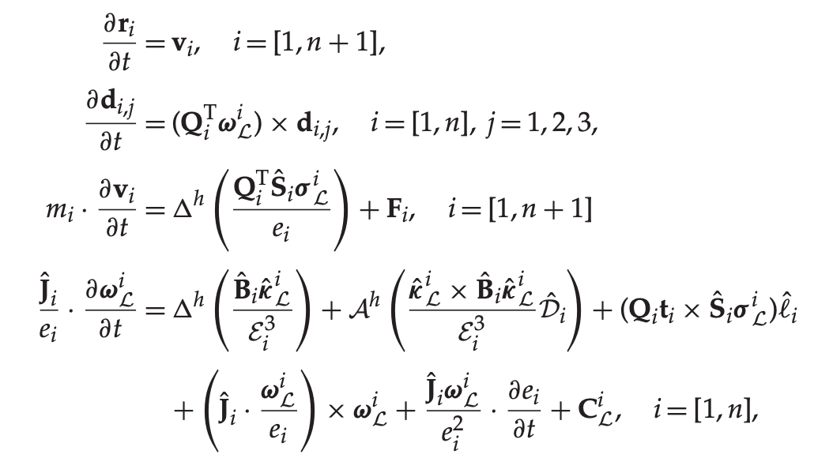
Data-Driven Control
Nonlinear system
Linear system
2021 Brunton & Kutz

Slide 39
Data-Driven Control
Challenges:
Nonlinear Dynamics
Unknown Dynamics
High dimensional
2021 Brunton & Kutz

Slide 40
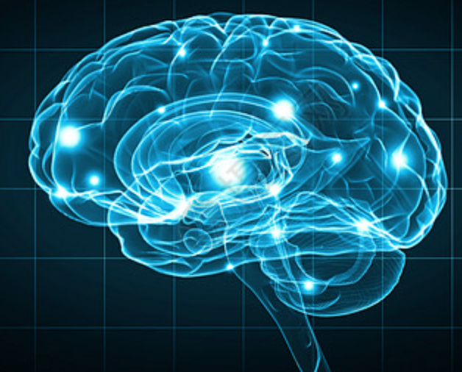
Data-Driven Control
Data-Driven model:
Linearize non-linear model(Koopman operator)
Learn model from data(SINDYc, DMDc)
2021 Brunton & Kutz

Slide 41
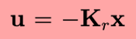
Data-Driven Control
Data-Driven model:
Linearize non-linear model(Koopman operator)
Learn model from data(SINDYc, DMDc)
Learn Control Policy
Naughton, Noel, et al. (2021)

Slide 42
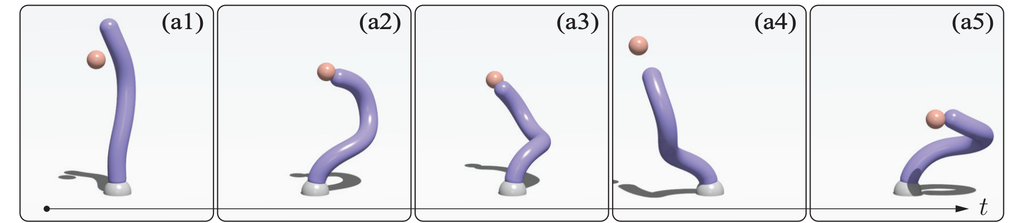
Data-Driven Control
Data-Driven model:
Linearize non-linear model(Koopman operator)
Learn model from data(SINDYc, DMDc)
Learn Control Policy
Naughton, Noel, et al. (2021)

Slide 43

Data-Driven Control
Data-Driven model:
Linearize non-linear model(Koopman operator)
Learn model from data(SINDYc, DMDc)
Learn Control Policy
Naughton, Noel, et al. (2021)

Slide 44

Model Predictive Controller(MPC)
2021 Brunton & Kutz

Slide 45

Model Predictive Controller(MPC)
2021 Brunton & Kutz

Slide 46


Model Predictive Controller(MPC)
2021 Brunton & Kutz

Slide 47

Model Predictive Controller(MPC)
2021 Brunton & Kutz

Slide 48

Model Predictive Controller(MPC)
2021 Brunton & Kutz

Slide 49


Model Predictive Controller(MPC)
2021 Brunton & Kutz

Slide 50

Model Predictive Controller(MPC)
PID and MPC
2007 E. F. Camacho , C. Bordons

Slide 51
Model Predictive Controller(MPC)
Challenges:
Fast Predictor
Online optimization
2007 E. F. Camacho , C. Bordons

Slide 52
Remark
Tuning PID Controller
Linear Quadratic Regulator
Data-Driven Control
Model Predictive Controller

Slide 53
Outlook
Implement MPC (SINDYc-MPC)
Implement Reinforcement Learning

